Slide 1
HOSPITAL PATIENT MANAGEMENT SYSTEM Name of Team Members: S.K. Rahul Lakshya Bhatia Omkar Vaity Batch Code: DA634S63 Project Guide: Komilla Bhatia

Slide 2
PROBLEM STATEMENT
The Hospital struggled with managing patient data, staff assignments, appointments, room allocations, and billing in different departments.
Manual processes caused inefficiencies, delays, and data inconsistencies. This project aims to create a centralized relational database.
It will streamline operations, improve data accuracy, and provide insights for better decision-making.

Slide 3
BUSINESS OBJECTIVE
To ensure accurate and coordinated patients record.
To automate all the appointments, billing, and room allocation.
To generate performance feedbacks.
To improve hospital efficiency through data-driven decision-making.
To ensure secured and auditable data retentions.

Slide 4
Business Objective Wise Questions
How is it possible to track patient appointments and their assigned doctors effectively?
Which departments are responsible for more patient admissions or higher revenues than others?
How to identify patients with allergies from complex JSON data?
How many patients have penicillin allergies?
Which doctor handled the most appointments?
How many rooms are currently available?
What is the distribution of Paid vs Unpaid bills?

Slide 5
DATA DESCRIPTION
TABLE NAME | DESCRIPTION
Patient | Stores patients medical and personal details
Staff | Stores information about hospital employees
Department | Stores details of all department's details
Appointment | Stores details of all scheduled appointments
Billing | Stores all details of payments
Room | Stores details about hospital rooms
OutPatient | Stores data for patients who receive treatments without being admitted.
OutPatientAppointment | Stores details for scheduled outpatients
OutPatientBilling | Stores details of outpatient payments

Slide 6
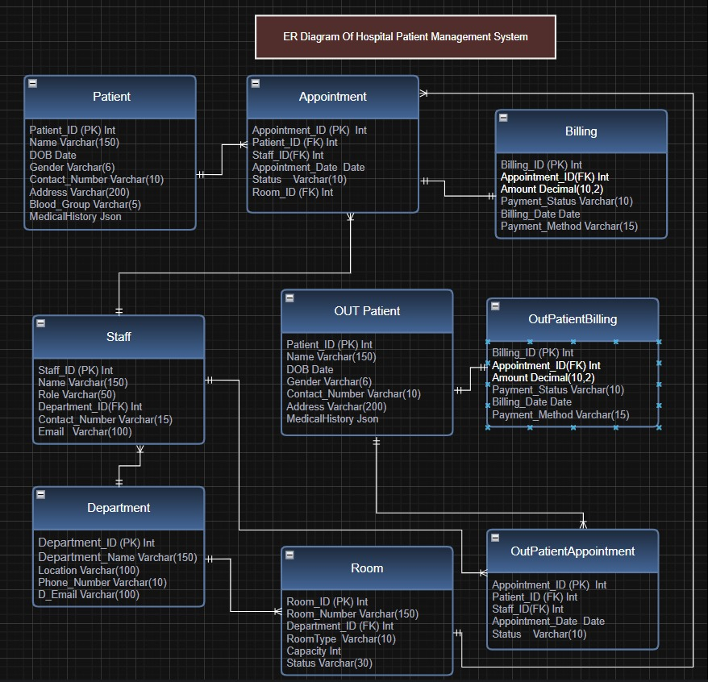
ER Diagram

Slide 7
Summary
A complete hospital database with 9 different tables which are connected using foreign key to ensure data integrity and consistency.
This system ensures that every interaction from scheduling appointments to billing is linked to get all insight of the patients.
The separate billing table ensures accurate tracking of hospital revenue for all the patients services which allow management to make easy financial decisions.
Connecting appointments table to staff and department records which ensures less paperwork by staff and allow more focus on patients by doctors.

Slide 8
CONCLUSION
The centralized hospital database significantly improves operational efficiency.
Accurate and connected records enable faster patient processing, reduced errors, and strong financial tracking.
The system provides department‑wise performance insights and ensures transparent audit trails for billing and appointments.
This analytical structure empowers hospital management to make quick, informed decisions.

Slide 9
Business limitations
The absence of a front-end interface means all hospital staff (doctors, nurses, billing clerks) must interact directly using SQL queries. This is impractical and creates a massive barrier to daily operational use.
The system's performance and reporting accuracy cannot be validated until it handles large, production-level datasets.
Hospital can face compatibility issues as system relies on advanced Json functions for handling medical history. If hospital uses older version of MySQL ,its core feature will fail.
The system doesn’t have automatic generation of dashboard which leads to slow, inconsistent and delayed business decisions.

Slide 10
Suggestions
Alerts: Implement SMS/email notifications for appointments to reduce not showing patients and increase staff efficiency.
Financial Compliance: Increase the audit system to track all the updates and deletions on critical records which ensures complete history for compliances.
User Interface: we must create flask or react based UI to make system operational for staffs.
PowerBI /Tableau: To make easy analysis of data for managers to see all the useful insights on clicks.

Slide 11
Thank you

